Slide 1
Surf Like A Pro: Using ITU Databases
10 May 2018
By Marion Hayes, University Librarian
ITU Library Website

Slide 2
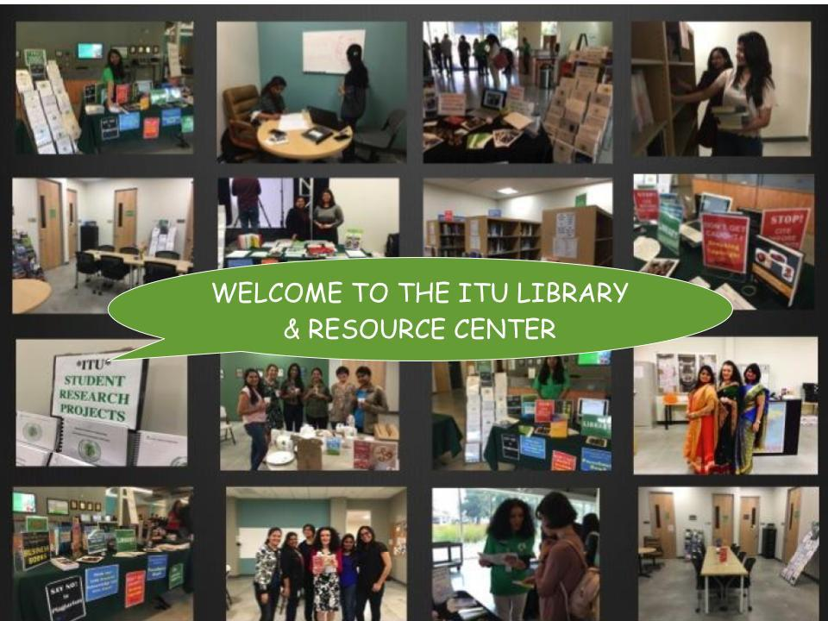
ITU Library Website
5/18/17

Slide 3


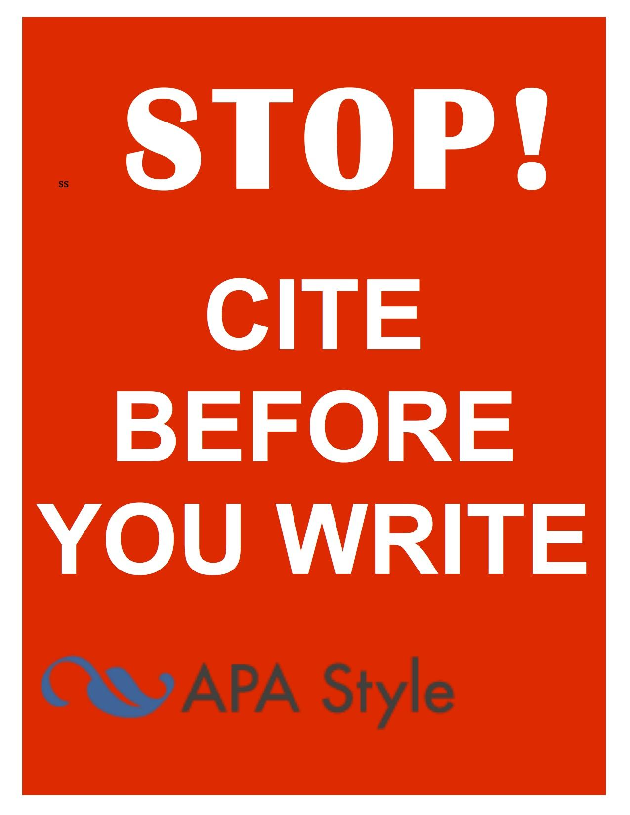
Remember this !

Slide 4
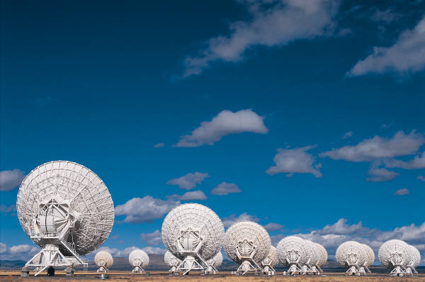
AFTER THIS WORKSHOP YOU WILL BE ABLE TO:
#1: Identify criteria for evaluating scholarly information
#2: Learn common search techniques
#3: Practice these techniques using ITU subscription databases
ITU Library Website
5/18/17

Slide 5
Academic Honesty
5
ATTENTION!!
Cheating, fabrication and plagiarism are unethical, behaviors at ITU see ITU’s Academic Dishonesty Policy and ITU Student Code of Conduct).
ITU defines plagiarism as:
“Representing someone else’s words, ideas, artistry, or data as one’s own, including copying another person’s work (including published and unpublished material, and material from the Internet) without appropriate referencing, presenting someone’s else’s opinions and theories as one’s own, or working jointly on a project, then submitting it as one’s own.”
Consequences - Failing or lower assignment/course grades, suspension/expulsion, loss of professional reputation, job or career.
2711 North First St. - San Jose, CA 95134 - www.itu.edu
library@itu.edu
11/7/17

Slide 6
CAN I GOOGLE? WHAT ABOUT WIKIPEDIA ? (Yes & No)
Google Scholar
Scholarly
“Advanced Search
Some are copyright-exempt
2. Google “Advanced Search” (Settings)
Limit by domain, title search only, file type
Good for images – select licensing desired
3. Wikipedia?
Scholarly? Background info.
Expert editors?
Reference lists with sections
4. What is a scholarly source?
5. Why use library databases?databases?
6. Free / Open Access Scholarly Database (EMS)
Google
Wikipedia
Library Databases
ITU Library Website
5/18/17

Slide 7
Using Google “Settings” for Pro Searching
From www.Google.com select “Settings” (bottom right screen)
Select “Advanced Search”
Select an option from “Usage Rights” such as “free to use share and modify”
To search for free to use images, go to Google images, change settings to “Advanced Search” and
Change Usage Rights to the option that best fits your use
Stark State Digital Library (2017). Copyright and Plagiarism Guide for Students
ITU Library Website
5/18/17

Slide 8
CRAAP Test: Identifying Scholarly Sources
Source: What Does Bad Information Look Like? - http://www.istl.org/18-winter/tips2.html
“Even within the realm of peer-reviewed literature, students still need to be able to think critically about the quality of information ”
Currency – date, last updated, enduring, broken links?
Relevance – topic, level of audience (child, adult)
Authority – peer review, author, publisher, .org, .edu, .gov
Accuracy – objective, unbiased, research protocol
Purpose – audience (academic, professional)
ITU Library Website
5/18/17

Slide 9
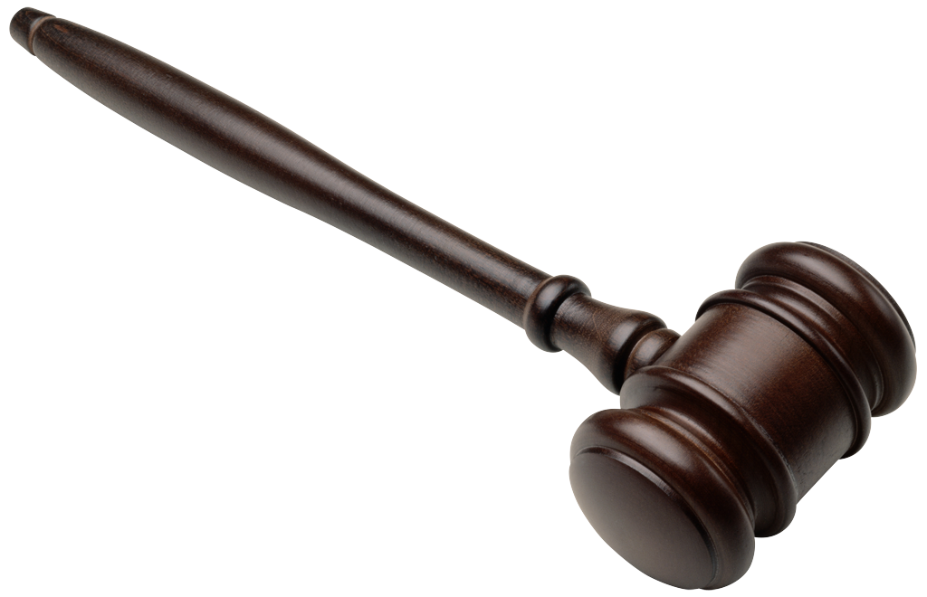
Scholarly?
Criteria | Tips
Authority / Publisher | Peer-reviewed, Expert, Opinionated, Factual, No Bias, Reputation
Organization | .gov .edu .org .com .net; Contents, Index
Currency | Last updated? Active links?
Accuracy | Sources? Citations, Verified?
Coverage /Scope | Relevance, sufficient details
Objectivity / Bias | Opinion or fact? propaganda
Other | Scholarly,News, Popular, Tabloids, Index, Table of Content
Appropriateness | Task, audience, advertising (agenda)
ITU Library Website

Slide 10
OPEN ACCESS (OA)
OPEN EDUCATIONAL RESOURCES (OER)
OA - online research outputs free of all restrictions on access and use (Wikipedia: https://en.wikipedia.org/wiki/Open_access
OER - free and openly licensed educational materials that can be used for teaching, learning, research, and other purposes (Creative Commons,https://wiki.creativecommons.org/wiki/What_is_OER%3F)
Examples:
ITU Electronic Information Resources (.xls) on the library website
Directory of Open Access Journals (DOAJ)
Arxiv.org
MIT Open Courseware
MSU Open Courseware
ITU Library Website
5/18/17

Slide 11
LIBRARY DATABASES
6. What library databases does ITU have
eLibrary tab in the EMS (onsite no passwords; login for off-site
ITU Online Library Catalog
ACM Digital Library
EBSCO Business Source Elite
NYTimes Academic Pass
Proquest Wall Street Journal
7. What are the best local libraries for research?
Joint SJPL & SSJU library (e.g. see LibGuides – 100s of databases)
Santa Clara University (e.g. see LibGuides – 100s of databases)
CA Public Libraries (e.g. Safari Books, Ebsco Source Elite
Google
Wikipedia
Library Databases
ITU Library Website
5/18/17

Slide 12
SEARCH TIPS
8. What common search tips and tools are used in most databases?
Example: MIT Search Tips Guide (Excellent)
Topic / question in one sentence
Background info (e.g. Wikipedia or Google)
Keywords or synonyms (similar)
Search strings
Boolean Operators AND, OR, NOT
Wildcards, truncation ? # book?
Stop word (e.g. ‘NOT’)
Sub topics
Keywords
Scholarly?
Limit?
Highly Recommended Source!!
MIT Libraries Search Tips, https://libguides.mit.edu/database-search, Accessed 18 Jan, 2018
5/18/17

Slide 13
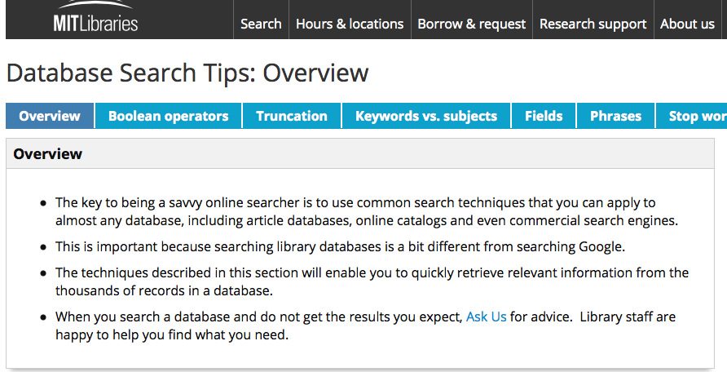
Scholarly Surfing
Highly Recommended Source: MIT Libraries, https://libguides.mit.edu/database-search, Accessed 18 January, 2018
ITU Library Website

Slide 14
EXAMPLE
“While potential benefits [to autonomous vehicles) are substantial, significant implementation and mass-market penetration barriers remain” (Daniel J. Fagnant, 2015. http://www.caee.utexas.edu/prof/kockelman/public_html/TRB14EnoAVs.pdf accessed Nov 8, 2017
In 1000 words, use scholarly literature to respond to this statement.
Step 1: Topic in one sentence (in own words)
e.g. What are the barriers to the widespread uptake of autonomous cars in the U.S.?
Step 2-3: Searching, selecting and saving citations (next page)
ITU Library Website
5/18/17

Slide 15
EXAMPLE:
Step 1: Topic in one sentence.
e.g. What are the barriers to the widespread uptake of autonomous cars in the U.S.?
Step 2: Find scholarly information and strategy
Keywords/phrases
Autonomous (vehicle* or car*) OR
Driverless / selfdriving / self-driving (vehicle* or car*) AND
market penetration or market barriers AND
Uptake or adoption or acceptance or …. AND
U.S.. or united states or north America AND
Databases:
Google: “Setting>Advanced Search”
ITU Library Catalog
Ebsco Business Source Elite
Search, Select, Download (Zotero, Mendeley)
Need help with Zotero or Mendeley? Submit a Library Inquiry or drop into the library.
ITU Library Website
5/18/17

Slide 16
How to surf like a pro
16
Did you receive your library logins
Use library catalog & databases for books, reserves, papers
Get a San Jose Public Library Card (SSJU Databases)
Know your Information literacy skills
Attend library webinars and workshops (flyer)
Get research help – library@itu.edu, research consultation
Know the research process – six steps (videos)
Use good search strategy, Boolean logic, keywords, wildcards
Know criteria to evaluate scholarly information
Use information legally – copyright, trademarks
Use information ethically - plagiarism, citation, turnitin
Use Tools/templates -ITU guides, APA style, turnitin, Zotero
2711 North First St. - San Jose, CA 95134 - www.itu.edu
library@itu.edu
11/7/17

Slide 17
REMEMBER TO
Schedule your research consultation with your University Librarian.
Email library@itu.edu
ITU Library Website
5/18/17

